Slide 1
McNair Academic Writing
Dr. Heather Talbott
University of Wyoming McNair Scholar’s Program

Slide 2
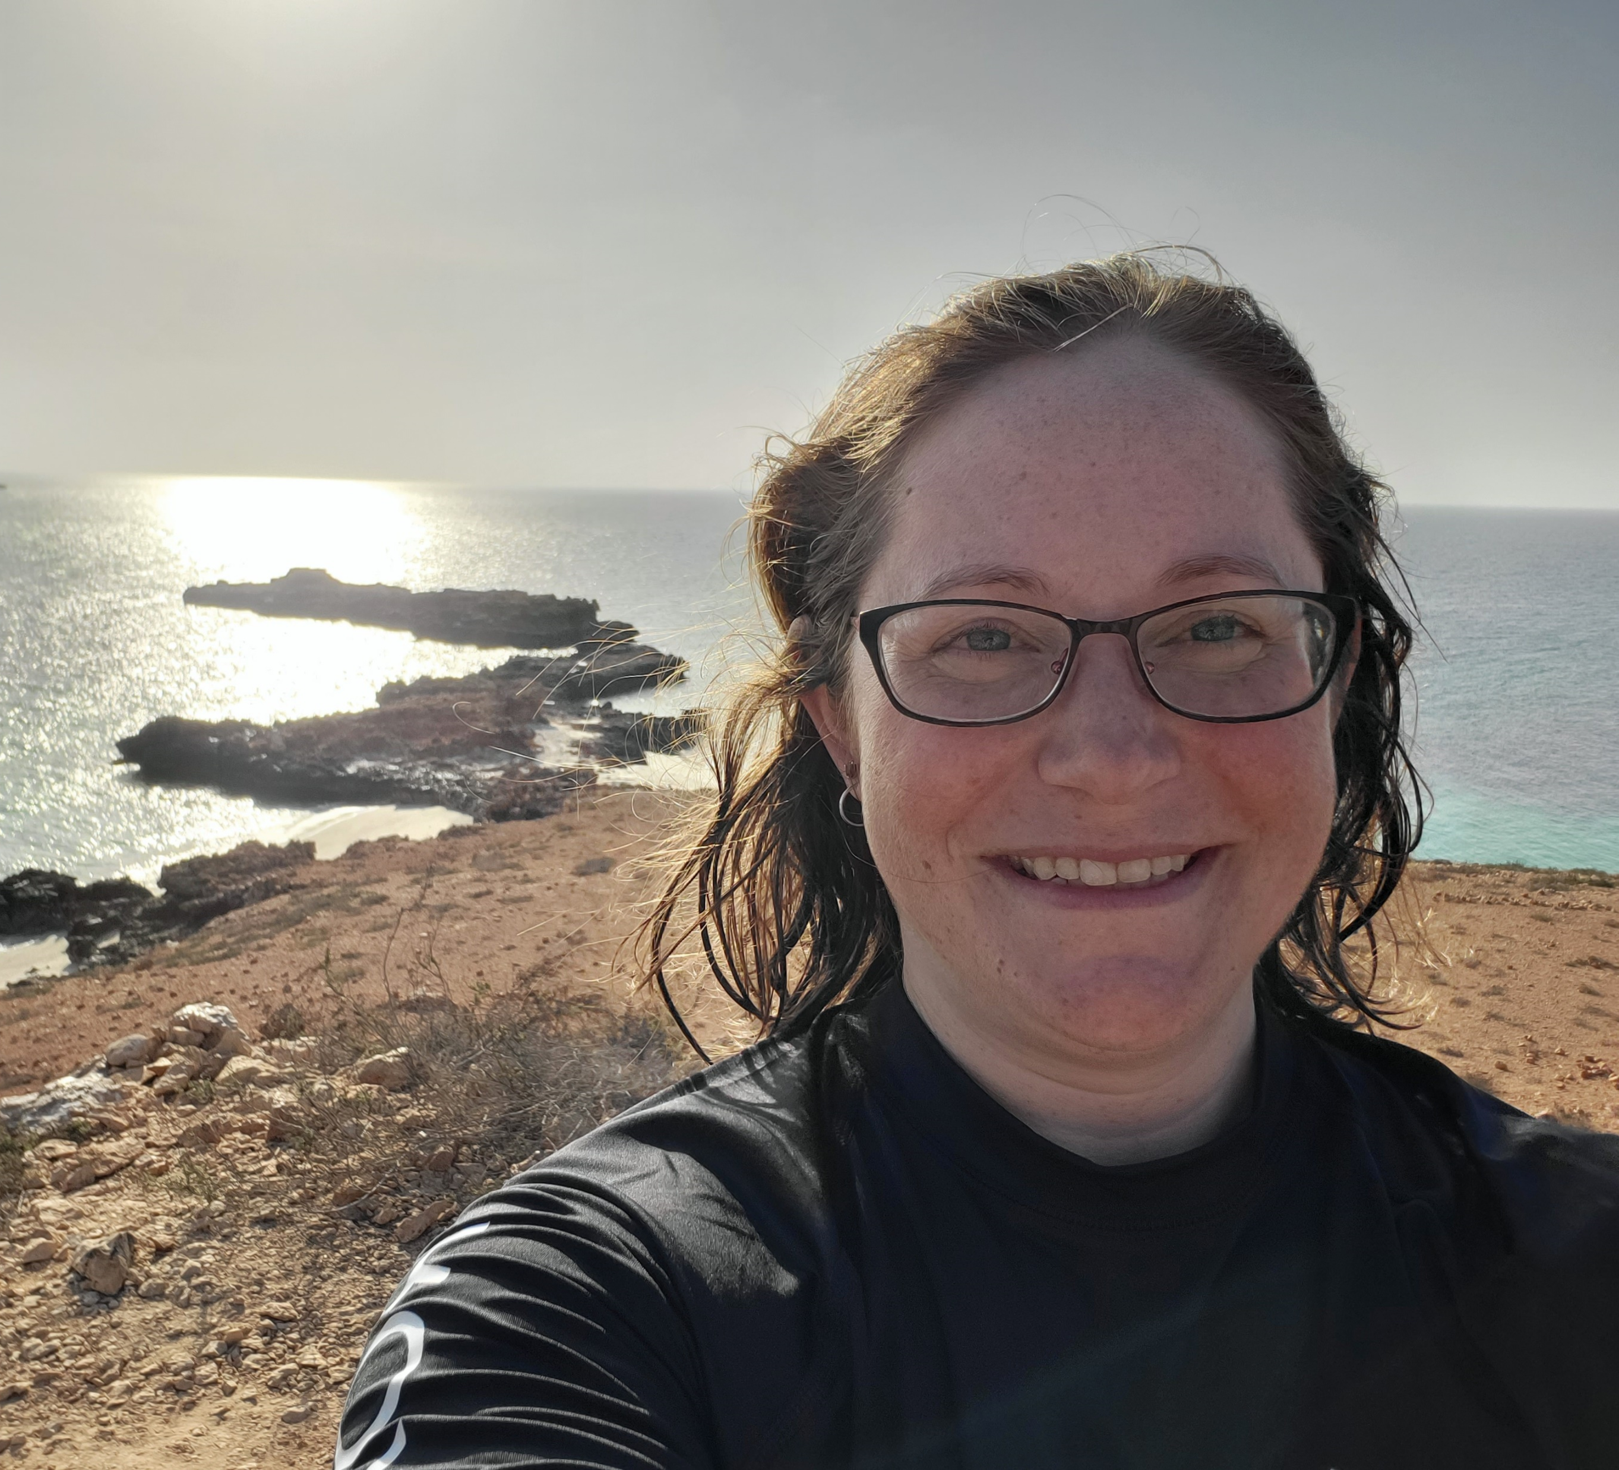
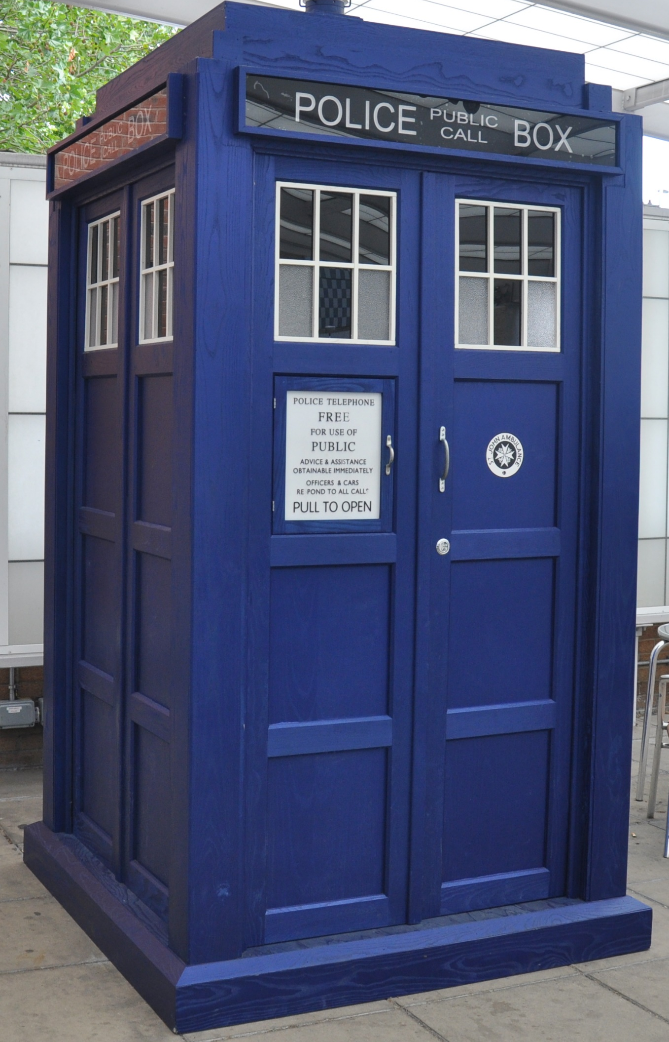
Dr. Who?
University of Wyoming – Class of 2010
B.S. Microbiology/Physiology
McNair Scholar
7 out of 7 grants
University of Nebraska Medical Center – Class of 2017
Ph.D. Biochemistry and Molecular Biology
6 first-author publications, 3 out of 3 grants
Oregon National Primate Research Center
Postdoc
1 first-author publication (in prep), 2 out of 4 grants

Slide 3

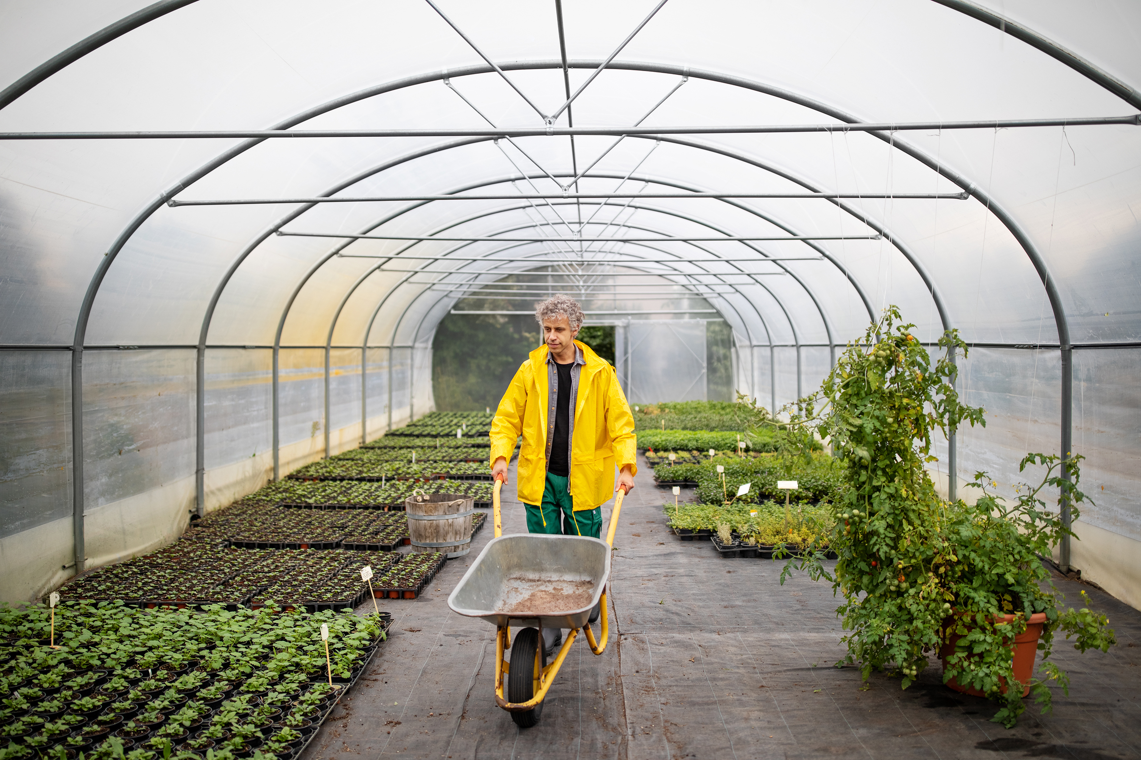






Dr. Talbott’s Hobbies and Interests
Notes:
https://www.classpop.com/magazine/how-to-swing-dance

Slide 4
Who are You?
Name Card
Group Card
Write your name LARGE
Add some drawings of your interests/hobbies/history/family
Decorate as you please (school appropriate)
Together choose an writing-themed group name.
You can use any resource to help generate a name

Slide 5
Small Group Activity: Peer Group Get-to-Know-You
Each member has ~5 minutes
Name, academic background
Career goals and why you are interested in graduate school
What your summer research project is about
What is your least favorite “ice-breaker” activity?
After each member’s talk, each other group member should ask a question

Slide 6
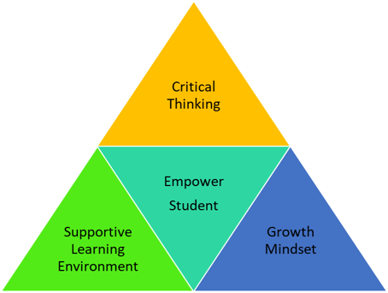
Teaching Philosophy
“If a [student] can't learn the way we teach, maybe we should teach the way they learn” -Ignacio Estrada
My goal is to focus on teaching the way you learn and empowering each of you to reach your maximum potential.

Slide 7

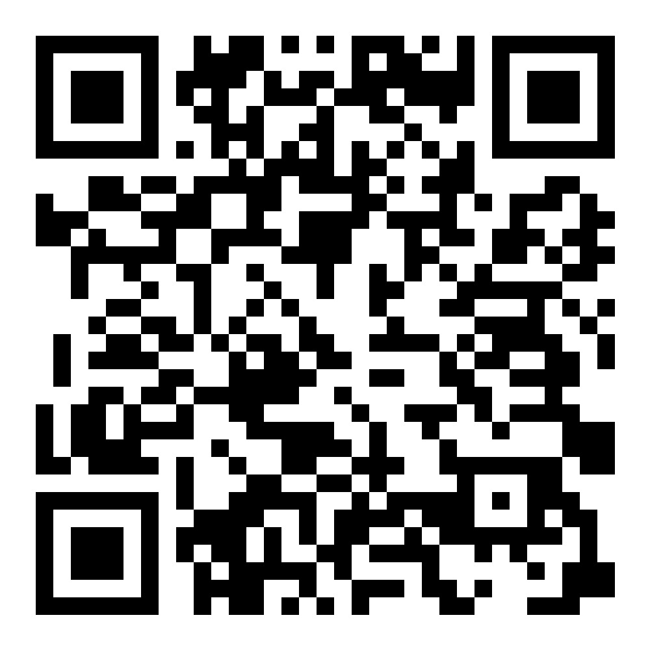
Supportive Learning Environment
joinmyquiz.com
Join Code: 8219 4311

Slide 8
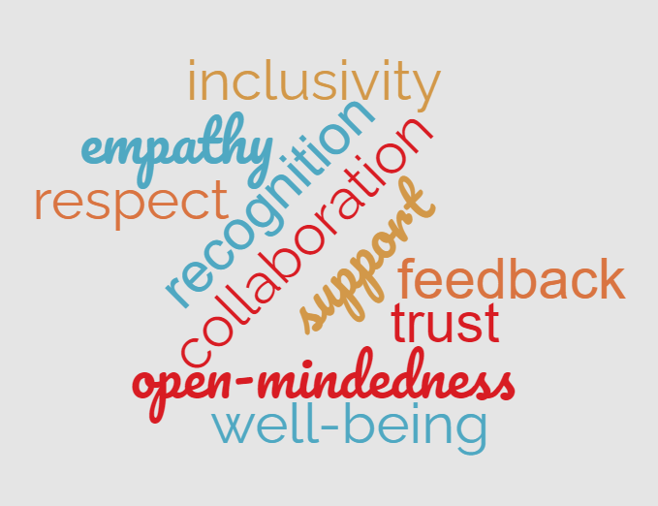
Dr. T’s Supportive Learning Environment
Attitude
Respect
Support
Open-mindedness

Slide 9
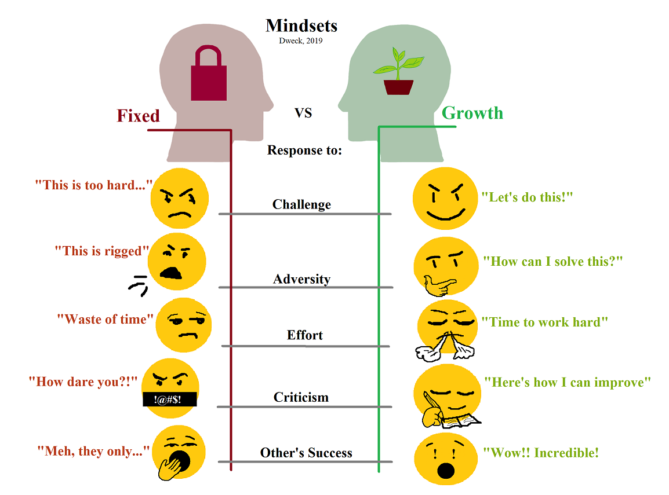

Growth Mindset
Mindsets
Dweck, 2019
Response to:
Challenge
Adversity
Effort
Criticism
Other’s Success

Slide 10
Critical Thinking
“The function of education is to teach one to think intensively and to think critically. Intelligence plus character – that is the goal of true education.”
Martin Luther King
Notes:
https://upload.wikimedia.org/wikipedia/commons/thumb/2/20/Critical_Thinking_Skills_Diagram.svg/2048px-Critical_Thinking_Skills_Diagram.svg.png
https://innovativeteachingideas.com/blog/critical-thinking-for-teachers-and-students

Slide 11

Course Goals
Writing a submission-ready academic paper
Assessing and reflecting on personal writing process
Skills and tools to succeed at academic writing in graduate school

Slide 12


Academic Paper

Slide 13
Course Goals
Writing a submission-ready academic paper
Assessing and reflecting on personal writing process
Skills and tools to succeed at academic writing in graduate school

Slide 14
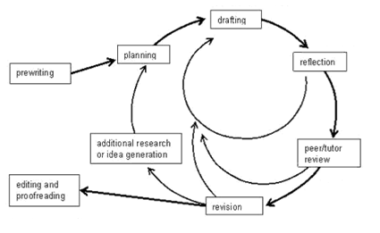

Writing Process
Notes:
https://www.lirvin.net/WGuides/wprocess.htm

Slide 15
Course Goals
Writing a submission-ready academic paper
Assessing and reflecting on personal writing process
Skills and tools to succeed at academic writing in graduate school

Slide 16
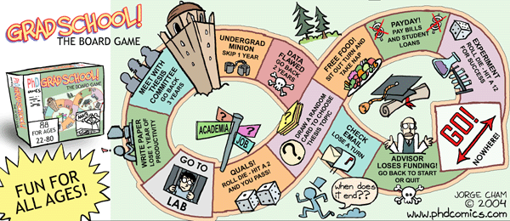
Grad School Map
Notes:
https://phdcomics.com/comics/archive.php?comicid=515

Slide 17
How?
Each week focus on one part of a typical academic paper
Lecture, workshop, and small group discussions
Groups of 3 will be reviewing each other’s work twice..
IMRaD (or AIMRaD) is now standard for ~90% of all papers.
(Abstract)
Introduction (6/20)
Methods (6/27)
Results (7/11)
and
Discussion (7/18)
Notes:
social sciences, natural sciences, or engineering and computer sciences

Slide 18
Schedule
Class: Tuesday 3-5 PM MST
Discord writing study hall

Slide 19
Course Structure and Goals
Need your feedback throughout the process
Rate It! Fist to Five
Completely Understand
Mostly Understand
Understand Pretty Well
Could Use Practice
Need Help
Don’t Understand at All

